Slide 1
Doug Morse
2015

Slide 2
Service Economics Group Charter / Mission
The key purpose Service Economics Group is to bring together a diverse team of individuals and organizations to help define and better understand current and desired future state economic tools, models, processes and technologies that would reduce inhibitors to current service innovation and to drive change that accelerate service innovation in the future. Ultimately the group would become an instigator / influencer of change to economic policies, economic and business metrics and accounting rules in support of the services economy.
This may include but is not limited to the following:
Create a center of knowledge and expertise around service economics
Use the COE ( Center of Expertise ) to drive change that promotes service innovation, new education models, public policy and economic models.
Understand new forms of value creation
Customer Equity – Customers as an asset – beyond ‘goodwill’
Value of Data (big data, sensor data et al.)
Touchpoint value ( Twitter, Facebook, other social media that collects visits and views )
Research and education of both micro and macro-economic models of service(s)
Definition and valuations of non-tangible economic transactions
Create and disseminate intellectual property (papers, books, presentations etc.) that create a better understanding of services related economics

Slide 3
% GDP from Service
Country Name | 2008 | 2009 | 2010 | 2011 | 2012 | 2013
United Kingdom | 77.2 | 78.5 | 78.7 | 78.4 | 78.9 | 79.2
France | 77.6 | 78.5 | 78.6 | 78.3 | 78.2 | 78.5
North America | 76.5 | 78.3 | 77.9 | 77.8 | 77.7
United States | 77.2 | 78.8 | 78.4 | 77.8 | 77.7
Italy | 71.8 | 73.8 | 73.7 | 73.7 | 74.2 | 74.4
OECD members | 73.0 | 74.7 | 74.1 | 74.0 | 74.2
European Union | 72.4 | 74.1 | 73.7 | 73.6 | 73.9 | 74.1
Euro area | 72.1 | 73.8 | 73.4 | 73.3 | 73.5 | 73.7
Singapore | 72.6 | 72.1 | 72.3 | 73.6 | 73.3 | 74.9
Japan | 71.3 | 72.8 | 71.3 | 72.7 | 73.2
Europe & Central Asia (all income levels) | 71.0 | 72.8 | 72.3 | 72.0 | 72.4 | 72.7
World | 68.9 | 70.6 | 70.0 | 69.7 | 70.1
Australia | 69.7 | 68.6 | 70.6 | 69.1 | 69.3 | 70.7
Germany | 69.2 | 71.6 | 69.3 | 68.7 | 68.4 | 68.4
Latin America & Caribbean (developing only) | 61.0 | 63.1 | 62.0 | 62.8 | 63.3 | 64.2
Central Europe and the Baltics | 62.7 | 63.7 | 63.3 | 61.9 | 62.4 | 62.4
Latin America & Caribbean (all income levels) | 59.7 | 61.6 | 60.4 | 61.1 | 61.7 | 62.5
Korea, Rep. | 61.2 | 60.7 | 59.3 | 59.1 | 59.5 | 59.1
Sub-Saharan Africa (all income levels) | 50.0 | 52.2 | 55.8 | 55.4 | 55.9 | 57.3
China | 41.8 | 43.4 | 43.2 | 43.4 | 44.6 | 46.1
Middle East & North Africa (all income levels) |  |  | 45.2 | 41.6 | 42.3 | 42.9
Source World Bank : http://data.worldbank.org/indicator/NV.SRV.TETC.ZS/countries

Slide 4
A Few Interesting Questions
How do we measure the services economy ?
Is Service Revenue double counted?
Are NAICS / SIC Codes and other classification systems are outdated?
Why do Businesses have to reach financial doom before expanding Services?
Do FASB Reporting and Revenue Recognition rules inhibit servitization?
What economic factors drive Services R&D? (private or public )
What economic factors affect national and international policies regarding Service?
How do labor laws affect the growth of services in world trade?
How do economic measures drive education?
Are Consumption Economics and Service Economics Related?
Are Services best measured as a 3rd Generation of the Industrial Revolution?
Can Customer Equity become a new measure to value companies?
What is the value of Data or core knowledge workers?

Slide 5
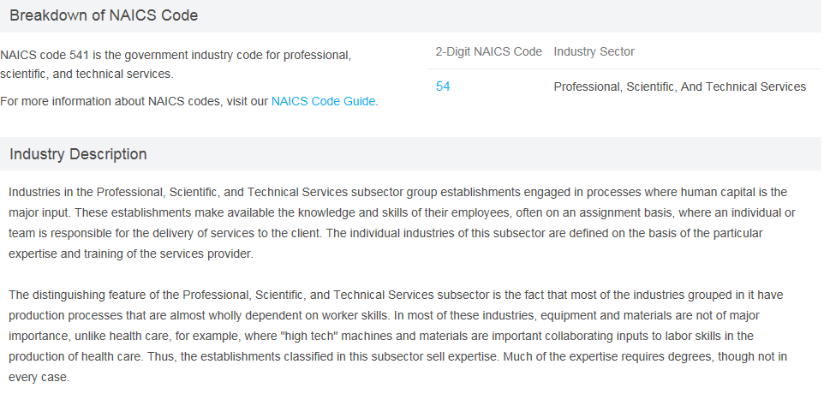
Why NAICS / SIC codes matter
For more info:
http://www.census.gov/eos/www/naics/

Slide 6
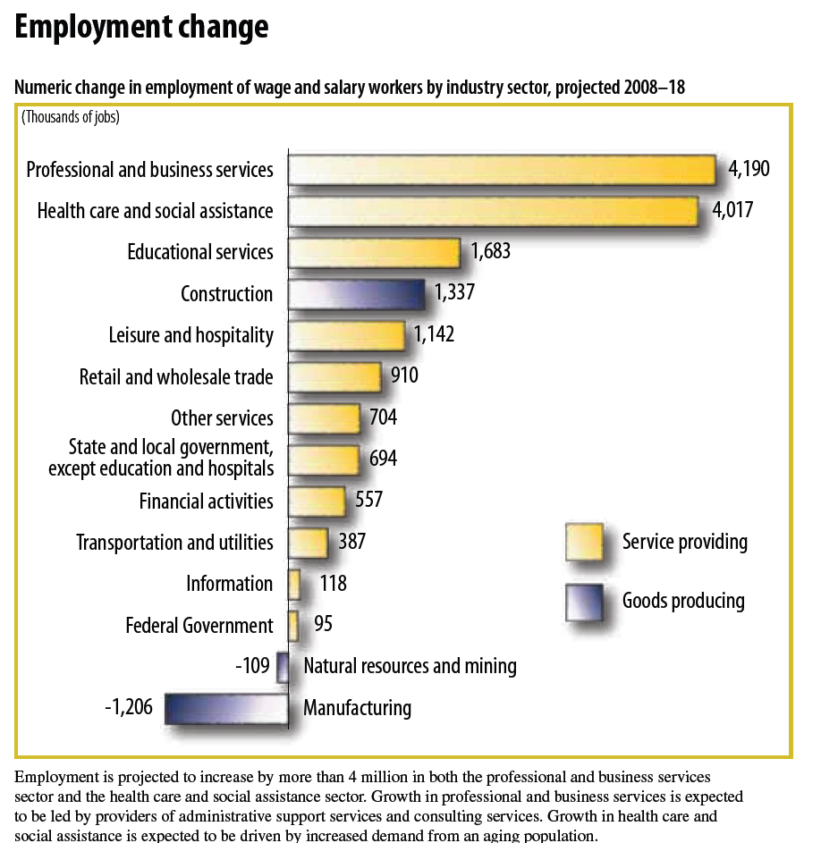
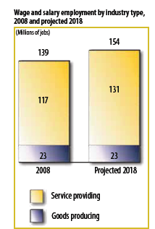
Projected US Service Employment Growth, 2008 - 2018
Service-providing industries are projected
to account for the most job growth between
2008 and 2018.
In goods-producing industries,
employment is projected to stay about
the same over the decade.
This is due, in
part, to increased demand
for services and
the difficulty of automating
service tasks.
US Bureau of Labor Statistics.
http://www.bls.gov/opub/ooq/2008/winter/art03.pdf
ServTrans LLC –All rights reserved

Slide 7
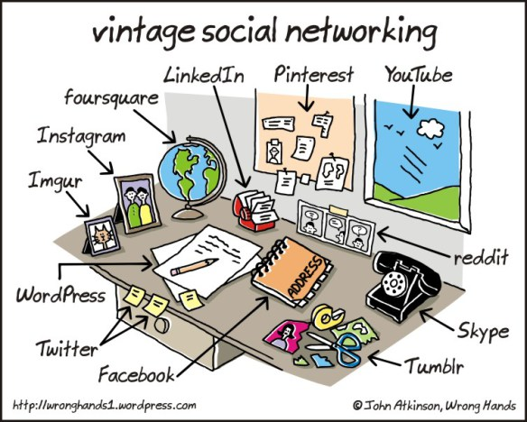
How many jobs were created or changed by new Services?
ServTrans LLC –All rights reserved

Slide 8

Manual labor to cognitive thinking

Slide 9




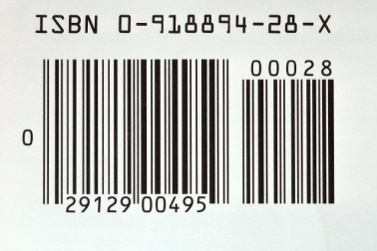







Global Economic Shifts
Ag Economy
Industrial Economy
Service Economy
ServTrans LLC –All rights reserved

Slide 10
Agricultural sector
Agriculture (a term which encompasses farming) is the process of producing food, feed, fiber and other goods by the systematic raising of plants and animals. Agricultural output is a component of the GDP of a nation.
Industrial sector
Industry is the segment of economy concerned with production of goods (including fuels and fertilizers). Industrial output is a component of the GDP of a nation. It includes mining and extraction sectors.
Service sector
A service is the non-material equivalent of a good. Service provision is defined as an economic activity that does not result in ownership, and this is what differentiates it from providing physical goods. It is claimed to be a process that creates benefits by facilitating either a change in customers, a change in their physical possessions, or a change in their intangible assets. Service output is a component of the GDP of a nation. The service sector includes farm and factory related activities
ServTrans LLC –All rights reserved

Slide 11
From Transaction to Value Exchange – definitions of service(s)
Complexity
Service (s)
The application of skills and knowledge (operant resources) for the benefit of another party . (Vargo and Lusch 2004a; 2006), Service Dominant Logic
Or
Service is any transaction of economic value that can not be dropped on your foot.
“The Economist “ -2006
Service System
Service has a greater focus on the management of knowledge as an asset and the channels through which knowledge, information and signals flow.
Therefore, a Service System is a dynamic configuration of value co-creating resources that
includes people, organizations, shared information, and technology connected holistically and organized to create new value outcomes by optimizing the creation and use of skills and knowledge for the benefit of others
Service Value Network
A (service ) value network is a web of relationships that generates economic value and other benefits through complex dynamic exchanges between two or more individuals, groups, or organizations. Any organization or group of organizations engaged in both tangible and intangible exchanges can be viewed as a (service) value network, whether private industry, government, or public sector.
Interpreted from: Verna Allee from ValueNetworks.com™
ServTrans LLC –All rights reserved

Slide 12

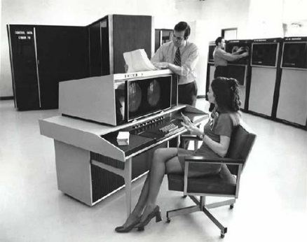


Economic Drivers of Business
Powered by Labor
Powered by Machines
Powered by Technology
Powered by Information
Powered by Customers
…Consumption Driven

Slide 13
Business Innovation Shift
Product Centric
Customer Centric
Outputs
Become
Outcomes
Products
Evolve into
Solutions
Transactions
Develop into
Relationships
Suppliers
Link up into
Partner Networks
Elements
Interconnect to become
Eco-systems
ServTrans LLC –All rights reserved

Slide 14




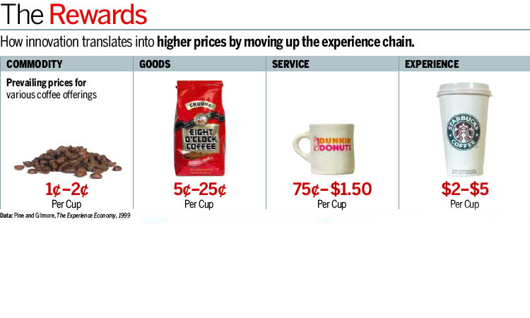
Relationship Creates Value
Transaction
Interaction
Experience
$
$$$
$$$$$
Browse
Search
Serve
Relationship
Commodity
Packaged
Service
Experience
Source: BusinessWeek 2005
ServTrans LLC –All rights reserved

Slide 15
Burning Platform (s)
Economic value principles are still deeply rooted in the Industrial economy and from work dating back to the late 1700’s by Adam Smith in his book, “The Wealth of Nations
Wealth is created by efficient creation of tangible assets
Money is a core driver of change and measurement of success so economic understanding is required
Servitization and Service Innovation are inhibited by antiquated economic measurement and classifications
We try to measure the intangible translated into tangible terms
Knowledge as an ASSET
Customer Goodwill (loyalty) as an ASSET
How do you measure the value of an OUTCOME?

Slide 16
Business Success and Valuations
Servitization – move from goods to services
Consumption economics is different than production economics
Revenue Recognition
Income to expense ratios reverse in consumption models - models become back loaded
Business Valuations
Value of customers
Value of “eye balls” ( target marketing )
Value of data ownership
Changes in Brand Value
Value Chain (Networks) vs. Supply Chain
Who is the customer?
Why Change ?

Slide 17
Business Metrics and KPI’s
Return on:
Capital, Investment, Assets
What is the new ‘leverage’ metric?
Bookings v.s Sales – Forecast models
Software License vs. Subscription
SaaS / PaaS / IaaS
View to sales conversion rates
Customer Equity
Lifetime Value of Customers
Experience Value
Why Change ?

Slide 18

Can We Define Simple Economic Models
Economic Drivers
Alumni $$$
Innovation
Industry Needs
Universities
Advancement of Knowledge
Creates
Research and Funding $$$
National Interests
IP and New Businesses
Natural or Unnatural Events
Public Policy
High Skilled Labor
Demand
Influence
Supply
Notes:
If we hope to change the education system around service and service science then we need to understand how they work. This is a simplistic model of how Universities, public or private are driven. Economics plays a huge role. One of things that drives Universities to create new course or disciplines is the demand for skill in the labor force. This demand needs to be measured in terms of impact. Today, a lot of this done via industry classification categorized mostly by NAICS ( SIC ) codes. However a majority of these industry classifications were created back in the 1930 by the Census Bureau. These were formulated around industrial models defined 200 years ago by Adam Smith, in the “Wealth of Nations”
If we want the right output from Higher Education then we need to provide different inputs and incentives that will drive change.

Slide 19
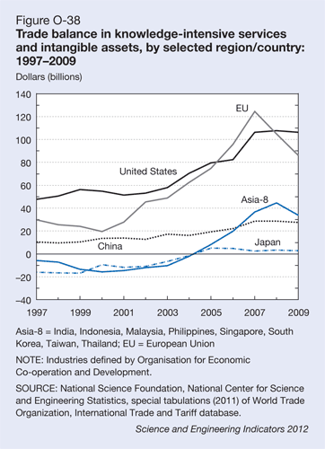
U.S. trade in commercial knowledge-intensive services and intangible assets—business, financial, and communications services, and payments of royalties and fees—has produced a consistent and growing surplus (figure O-38). It reached a record $108 billion in 2008, sufficient to counter-balance the high-technology goods deficit, and has been flat since then, reflecting the recession's effect. The EU's surplus was sharply off, and that of the Asia-8 fell as well—reflections of the continuing effects of the global recession.
NSF Science and Engineering Indicators 2012

Slide 20
Some Informational Links
How Do We Measure the Services Economy ?
Service as Percent of GDP
http://wdi.worldbank.org/table/4.2
http://data.worldbank.org/indicator/NV.SRV.TETC.ZS/countries
U.S. Bureau of Economic Analysis ( BEA )
http://www.bea.gov/itable/index.cfm
NAICS / SIC Codes and Other Classification Systems are outdated
http://www.census.gov/eos/www/naics/
Are Consumption Economics and Service Economic Related?
http://www.tsia.com/research/books-by-tsia/consumption-economics.html
Nation Master Data
http://www.nationmaster.com/country-info/stats/Economy/GDP
Are Services best measured as a 3rd Generation of the Industrial Revolution?
http://www.theguardian.com/sustainable-business/jeremy-rivkin-third-industrial-revolution

Slide 21
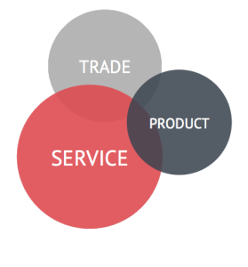
Discussion?

Slide 22
U.S. services driving overall exports growth, topping half a trillion dollars
The U.S. Department of Commerce’s Economics and Statistics Administration (ESA) released a report showing U.S. trade in private services totaled $526.6 billion in 2010, representing a trade surplus that is growing, rising from $66.7 billion in 2003 to $168 billion in 2010.
By country, the largest U.S. surpluses in services are with Canada, Japan, Ireland, Brazil, the United Kingdom, China and Mexico. The U.S. services surplus with China has accelerated rapidly since 2007, from $2.4 billion to $10.4 billion in 2010, because of sharp gains in exports and relatively flat imports, according to ESA data.
Exports support more than 10 million American jobs, and those whose jobs depend on trade earn 13 to 18 percent more than the national average. As a result of administration policies and the global economic rebound, exports grew 17 percent in 2010 compared to 2009 – the largest year-to-year percent change in more than 20 years.
Private services are defined as non-tangible items of value that are either consumed when purchased or at a later date by their terms of sale, such as school tuition or an airplane ticket. These are distinct from tangible items, or “goods,” such as oranges or motor vehicles.

Slide 23
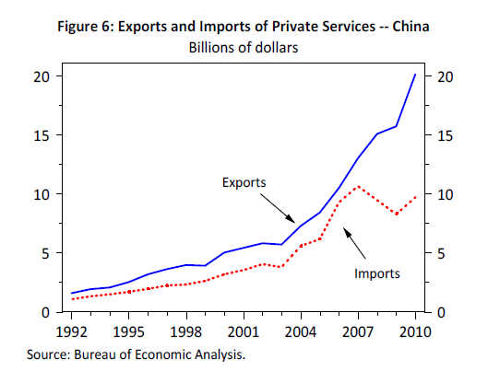
U.S. Surplus with China is Growing Rapidly Figure 4: Trade Balance in Private Services Billions of dollars 1992 1995 1998 2001 2004 2007 2010 -40 -200 20 40 60 80 100 -40 -20 020 40 60 80 100 Royalties and license fees Travel and fares Freight and port use Other private services Source: Bureau of Economic Analysis. Figure 5: Largest U.S. Surpluses and Deficits by Country in 2010* Private services trade, billions of dollars Canada Japan Ireland (2009) Brazil United Kingdom China Mexico India Bermuda (2009) -30 -20 -10 0 10 20 30 Source: Bureau of Economic Analysis. * 2009 data is used if 2010 is not available.

Slide 24
