Slide 1
“It’s the CUSTOMER, stupid…” The simple truths about pricing
ISSIP Service Economics COI
Oct 2015
Doug Morse
Founder / Chief Inspiration Officer
ServTrans LLC

Slide 2
QUIZ Time
Who sets the service prices at your company?
Is it the product manager of whatever product or service?
Is it a senior executive in the organization
Is it corporate marketing department?
Is it someone in finance?
None of the above?

Slide 3
QUIZ Time
Who sets the service prices at your company?
Is it the product manager of whatever product or service?
Is it a senior executive in the organization
Is it corporate marketing department?
Is it someone in finance?
None of the above – Your customer arbitrates the real price

Slide 4
Simple Truths About Pricing
basic truth number #1:
Customers get to choose the PRICE; YOU get to choose the VALUE.
or?
Perceived Value
Intrinsic Value
Variable Value

Slide 5
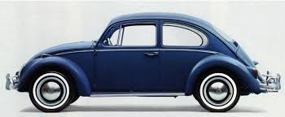
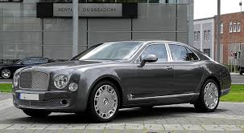
Simple Truths About Pricing
Basic Truth number 2:
IF it doesn’t sell the problem is the value, not the price!
OR
“I need a car for work”
How do I choose?

Slide 6
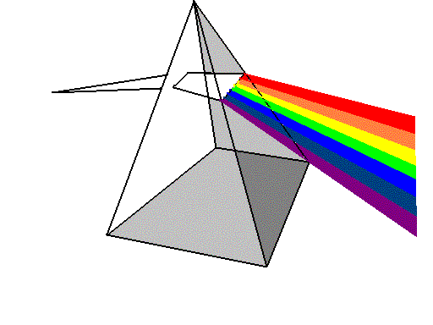
Simple Truths About Pricing
Basic Truth number 3:
The Value is a matter of perspective – Prism Theory
Continuum of Needs
Established
Skills
Planning
Changing
Prism
of Services
Support
Growing
Implementation
A Customer’s Perspective of Value Changes in
Relation their Relative NEEDs at a POINT in TIME.
New

Slide 7
Simple Truths About Pricing
Basic Truth number 4:
Pricing is a strategic process and not just a marketing task
What Business are you in?
What behavior(s) are you trying to promote or influence
What problems are you trying to solve?

Slide 8
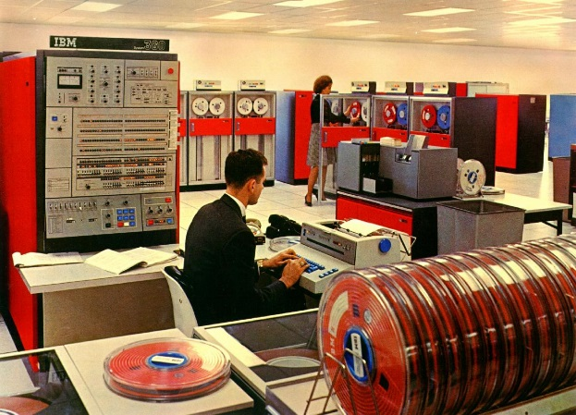
Simple Truths About Pricing
Basic Truth number 5:
If the Value is not right, then pricing does not matter
Who is the recipient of value?

Slide 9
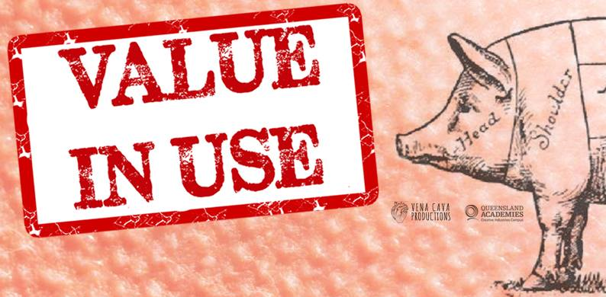
Simple Truths About Pricing
The lasting truth
best practices just follows someone else’s innovation
Value in Outcome

